Slide 1
Flower Classification Using GoogleNet & Sparse SVM Team: Bala Chethan Chowdary Mallavarapu Abhigna Reddy Mareddy Yaswanth Paruchuri Tej Deep Parvatha Reddy

Slide 2
Problem summary
Plant identification is an important task for researchers, students, and practitioners in field of the agriculture, forest, biodiversity protection, and so on.
Recently, thanks to advanced research in the computer vision community, a number of works have been dedicated to the automatic plant identification based on images of plant organs (e.g., leaf, leafscan,fruit, stem, entire, stem, flower).
Among them flower image plays an important role for the plant identification because its appearances (e.g., color, shape, texture) are highly distinguishing.
Appearances of flowers are stable and less invariant with weather conditions, age of plant.
In views of the botanic experts, flower images therefore are most valuable source for the plant identification task.
However, to develop an automatic plant identification system based on flower images, the proposing techniques face to many challenges such as large inter-class similarity, but small intra-class similarity, lighting and viewpoint variations, occlusion, clutter, and object deformations

Slide 3
Problem summary
Among organs of plant, flower image plays an important role because its appearances are highly distinguishing.
Moreover, flower’s observations are stable and less invariant with weather conditions, age of trees, or other artifacts.
A number of traditional features have been proposed for basic-level category of the recognition task.
However, these approaches may eliminate many useful natural cues during the feature extraction.
They also require domain-related expert knowledge. In this project, sparse SVM is used as primary classifier to learn the dataset.

Slide 4
Dataset Summary
Context
This dataset contains 4242 images of flowers. The data collection is based on the data flickr, google images, yandex images. We can use this dataset to recognize plants from the photo.
Content
The pictures are divided into five classes: chamomile, tulip, rose, sunflower, dandelion. For each class there are about 800 photos. Photos are not high resolution, about 320x240 pixels. Photos are not reduced to a single size, they have different proportions!
https://www.kaggle.com/alxmamaev/flowers-recognition

Slide 5
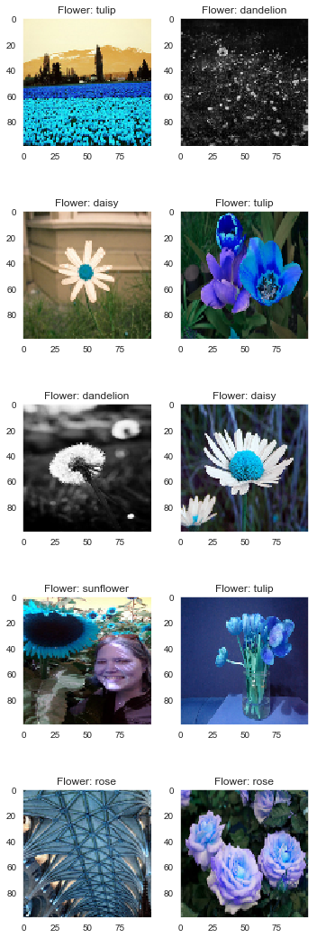
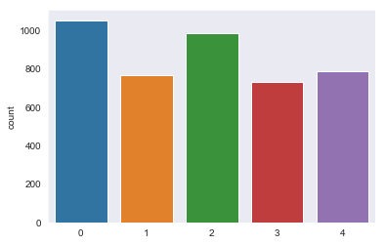
Dataset Summary

Slide 6
Progress Summary
Data Acquisition
Pre Processing
Feature Extraction
GoogleNet
Test Image
Classification
Benefits Module

Slide 7
Work summary
Flower images are normally captured on complicated background with the presence of different objects.
Even, sparse SVM & CNN can be applied directly on these images, in order to evaluate the effect of background for flower identification;
We deploy some preprocessing techniques on flower images.
The results extract only flower regions from a natural image.
Support vector machines (SVMs) have been an efficient tool for classification and pattern recognition with many applications in different fields.
SVM is a constrained margin maximization problem based on the risk minimization principle.
It is formulated into a convex quadratic programming and can be solved efficiently.
CNN is the one of the most famous deep learning approaches where multiple layers are training.
A CNN typically comprises multiple convolutional and sub-sampling layers, optionally followed by the fully-connected layers like a standard multi-layer neural network.

Slide 8
GoogLeNet
The input layer of the GoogLeNet architecture takes in an image of the dimension 224 x 224.
Type: This refers to the name of the current layer of the component within the architecture
Patch Size: Refers to the size of the sweeping window utilised across conv and pooling layers. Sweeping windows have equal height and width.
Stride: Defines the amount of shift the filter/sliding window takes over the input image.
Output Size: The resulting output dimensions(height, width, number of feature maps) of the current architecture component after the input is passed through the layer.
Depth: Refer to the number of levels/layers within an architecture component.
#1x1 #3x3 #5x5: Refers to the various convolutions filters used within the inception module.
#3X3 reduce #5x5 reduce: Refers to the numbers of 1x1 filters used before the convolutions.
Pool Proj: This is the number of 1x1 filters used after pooling within an inception module.
Params: Refers to the number of weights within the current architecture component.
Ops: Refers to the number of mathematical operations carried out within the component.

Slide 9
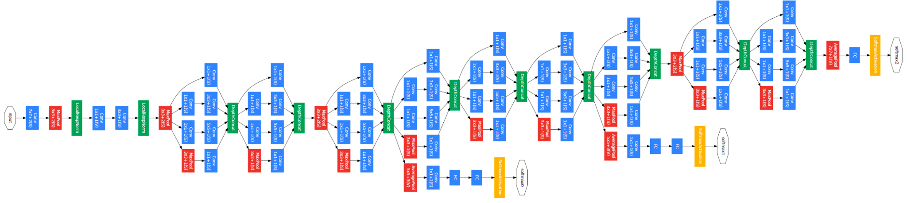
GoogLeNet

Slide 10
Sparse SVM
However, standard SVM, minimizing the hinge loss function and L2 norm, only leads to sparsity for the dual variables, but not the primal variables.
To handle the big omics data problem with a lot of features, support vector machines with other penalties including L1 and elastic net have been proposed for feature selection and prediction.
However, these methods are directly dealing with the primal variables.
They are not computationally scalable when the number of features (genes) is large, which is common in big omics data.

Slide 11
Validation method
Precision
Precision calculates the ability of a classifier to not label a true negative observation as positive.
Precision=TP/(TP+FP)
Recall (Sensitivity)
Recall calculates the ability of a classifier to find positive observations in the dataset. If you wanted to be certain to find all positive observations, you could maximize recall.
Recall=TP/(TP+FN)

Slide 12
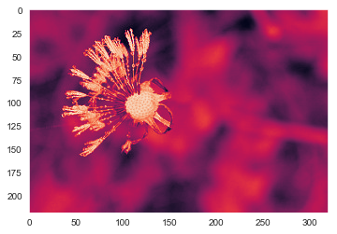
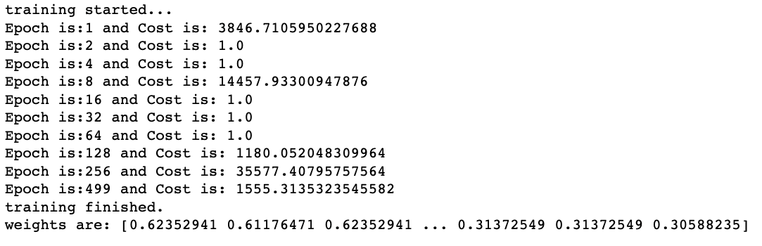

Sparse SVM Results
The results of the analysis of this study were observed with the test dataset.
The new feature set was classified with the SVM classifier and classification accuracy rate was 26%

Slide 13
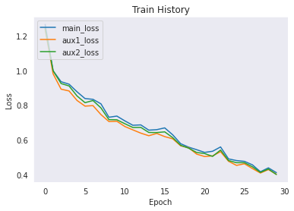
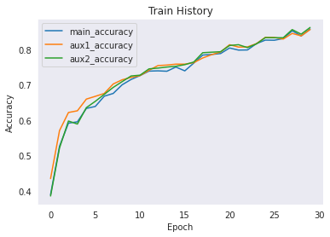
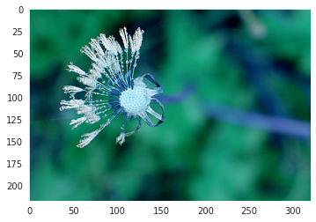

GoogLeNet Results

Slide 14

Project – User Interface
http://52.71.29.8:5000/
We have deployed our application to an AWS server hosted on the above URL.

Slide 15
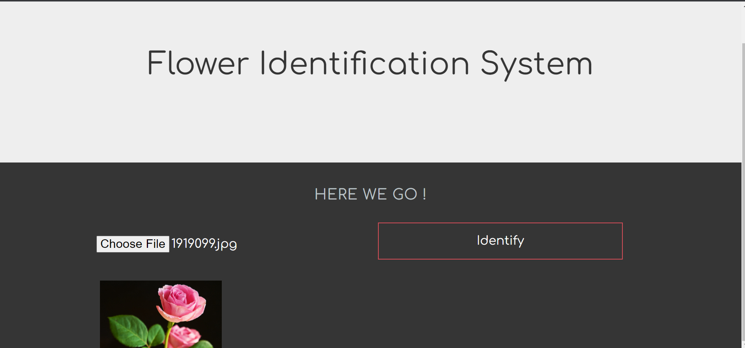
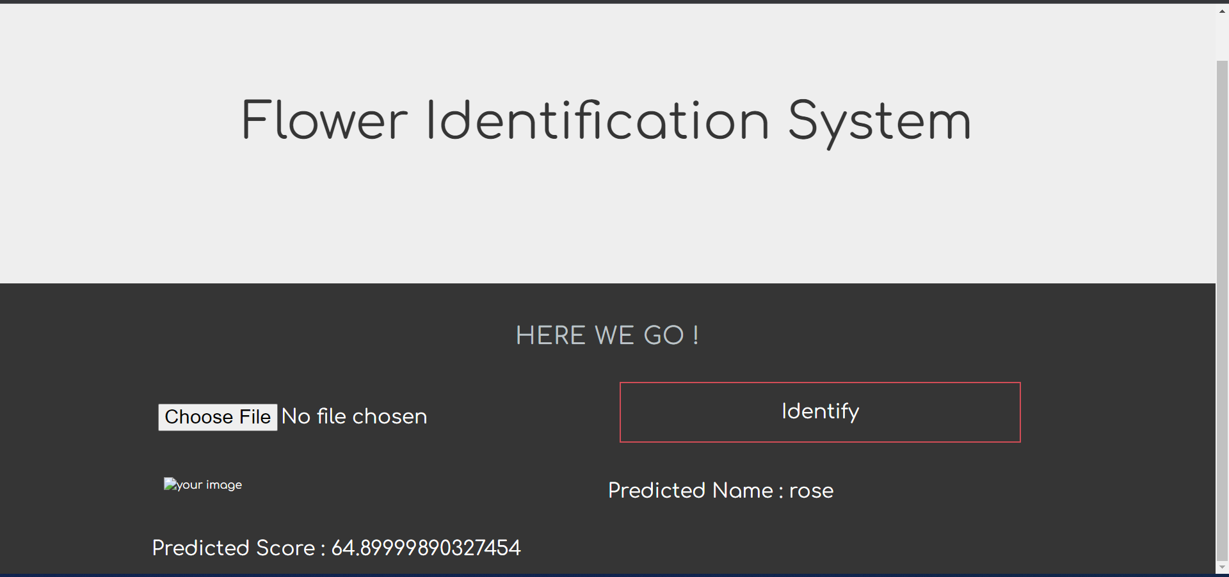
Predicted Results
Now we have given input of a flower and clicked on Identify. The system classifies the image and shows the output with Predicted Name name and Predicted Score.

Slide 16
Conclusion
The classification of flower species is a difficult task. Especially herbs, leaves, etc. on and around the flowers make it more difficult to detect flower species.
Traditional methods have been effective in classifying flower species.
However, in recent years one of the preferred approaches to achieve more successful results in such classifications is deep learning models.
Deep learning models can directly extract the features from input data without using any feature extraction process, unlike traditional methods.
The main aim of the googleNet model was to extract the features found at the intersection of the feature sets obtained with the feature selection methods.
These features are considered more stable features and the results obtained in the study support this idea.
The overall accuracy rate of the five flower classes was 98.91%.
In future studies, we will examine the different datasets using attention modules.

